Slide 1


Hope to Skills
Lecture#01
Instructor: Irfan Malik, Dr. Sheraz Naseer

Slide 2
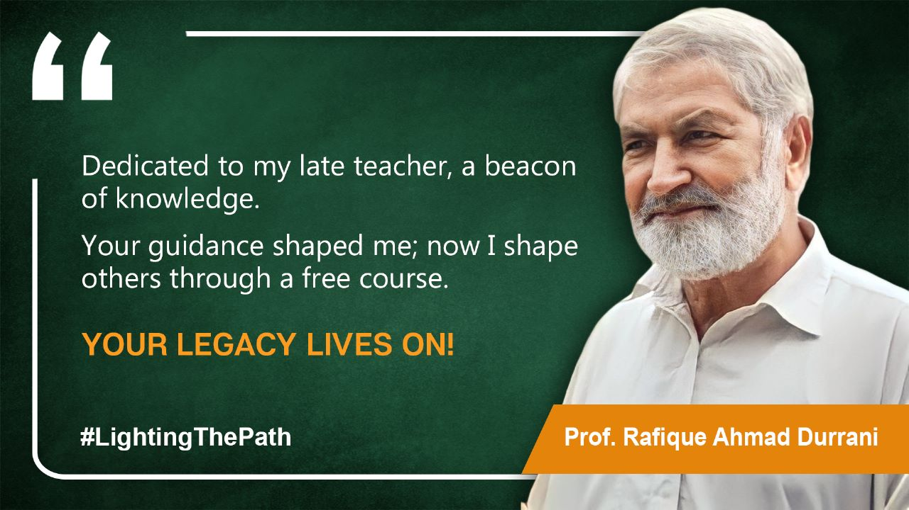

Slide 3
Lecture#01

Slide 4
Our Goal for This Course
Skill Development
Hands-on learning
Problem-solving and critical thinking
Practical experience and portfolio building
Effective self-presentation
Fostering a culture of knowledge-sharing

Slide 5
Our Expectations from Students
Active participation in practical exercises and assignments
Practical experience and portfolio building
Sharing knowledge and teaching new batches

Slide 6
Working Plan
Lecture Delivery: Comprehensive lectures on various topics
Through Evaluations: Regular evaluations after each lecture
Hands-on Practice: Hands-on practice for each module
Projects and Assignments: Real-world projects and assignments
Small Project Completion: Small projects upon completing each module
Guidance and Support: Ongoing guidance and support throughout the course

Slide 7
Work Ethics
Be punctual and respect others' time.
Maintain professionalism in all interactions.
Take responsibility for your work and actions.
Communicate effectively and respectfully.
Collaborate and contribute positively in teams.
Manage your time efficiently and meet deadlines.
Be accountable for your assignments.
Foster a positive and supportive work environment.

Slide 8
Practical sessions
There will be hands-on practise session during each lecture.
You will be given task to solve in order to understand the concept
The purpose is to make you learn the topic so feel free to ask questions

Slide 9
Evaluations
Evaluations may Include
Quizzes
Assignments
Projects
Presentations
To focus on the professional grooming.
The Evaluations Will be uploaded on the Google Classroom.
It is compulsory to meet the Deadlines for each evaluation.

Slide 10
What is Artificial Intelligence?
Artificial Intelligence (AI) refers to the ability of machines to perform tasks that would normally require human intelligence
AI is used in many everyday technologies

Slide 11
What is future going to be like?
Increased efficiency and automation
Improved healthcare
Smarter cities
Enhanced customer experiences
Increased access to education

Slide 12
Agenda
1- AI concepts and applications
2- Overview of Previous discussion
3- Unsupervised Learning
4- Reinforcement Learning
5- Deep Learning
6- Relationship between AI, ML and DL
7- Questions and Answers

Slide 13
Object detection

Slide 14
Object detection

Slide 15
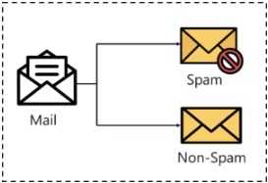
Classification

Slide 16
Segmentation

Slide 17
Segmentation

Slide 18
Generative Models

Slide 19
Chatgpt

Slide 20

Stable-diffusion

